Slide 1
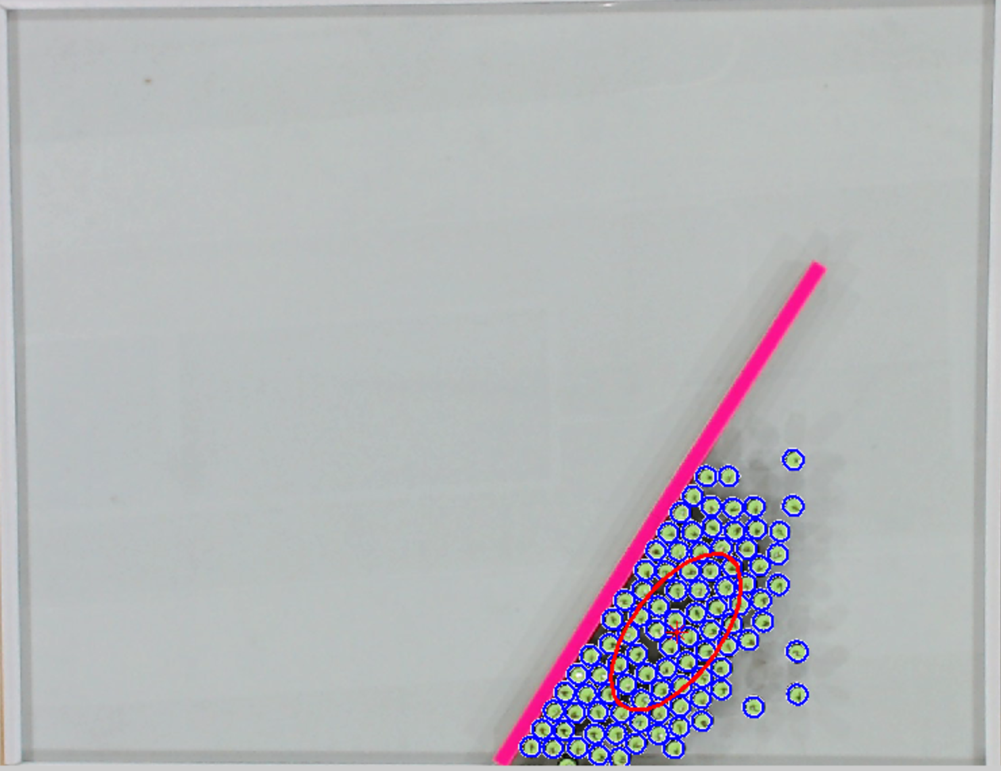

Detected Robots
Object
Goal
Notes:
Draw

